Slide 1



BCC Iteration 2
By: Connor Woodahl, Kevin Kulda, and mark Fuller

Slide 2
Diagrams

Slide 3
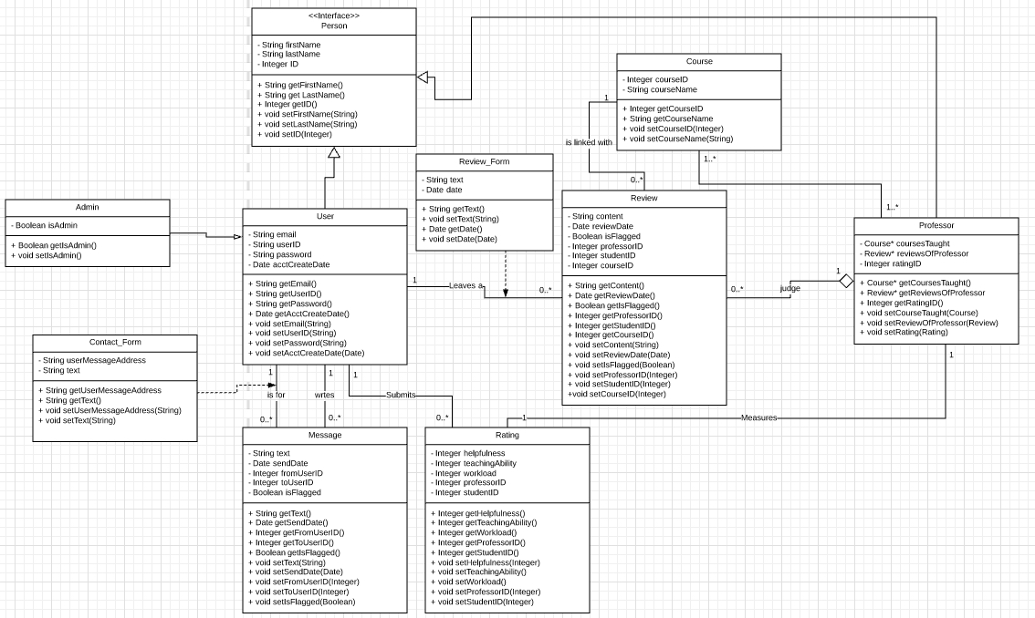

Slide 4
Sequence Communication Diagrams

Slide 10
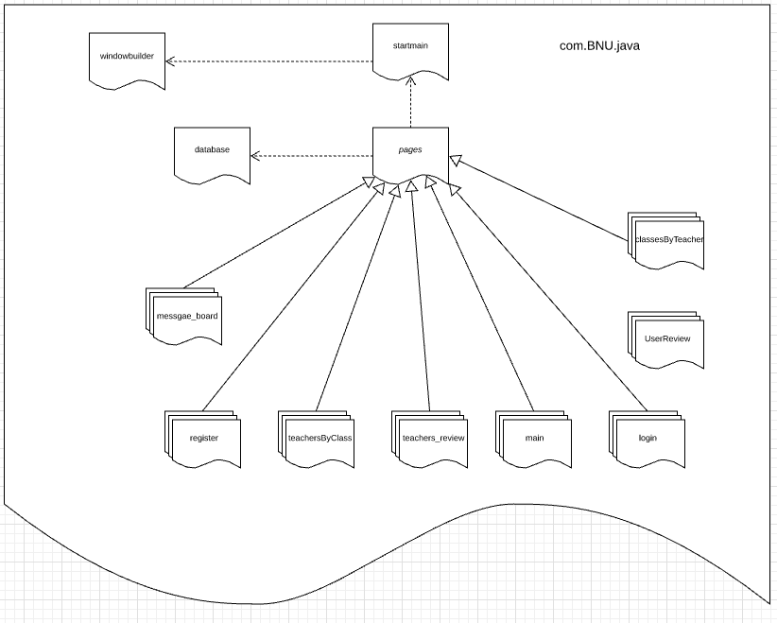

Slide 11
Grasp Justification
Each page is an individual package containing all the functionality needed required to load that page. Using the MVC model we are able to atomize the datatypes, logic, and view of each page.
Each pages Controller contains instances of the view, model, and panel that that page will display, as well as a reference to the database where data can be fetched for displaying.
Each Model contains the datatypes required to build the page. If the model represents a Java Swing pane then it contains mostly the JComponents that will be displayed on that page.
Each View builds the model JComponents into the pane that is stored by the Controller.
The database is currently wrapped with an API that will mimic the database when it is fully implemented. However it is currently hard-coded.

Slide 12
Coverage Plan
Each Controller and View will have test classes dedicated to them.
The Model currently has no implementation other than getters and setters, therefore does not need a testing suite.
The View of each page will be tested for loading errors by mocking the Controller for values.
The Controller will be tested using a mocked view to check for valid GUI generation and exception handling, It will also have tests for the functionality it contains within itself for database query routing.

Slide 13
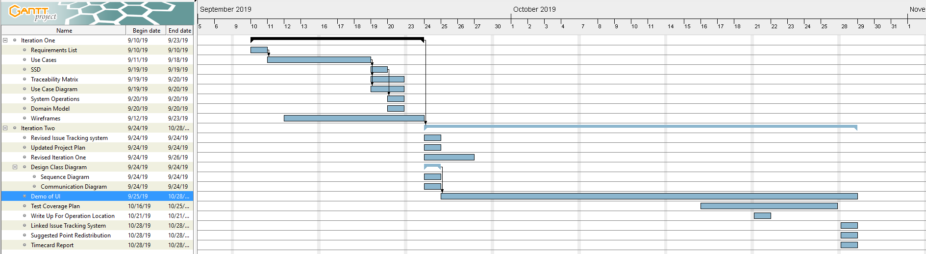
Gantt Diagram

Slide 14
Demo

Slide 15
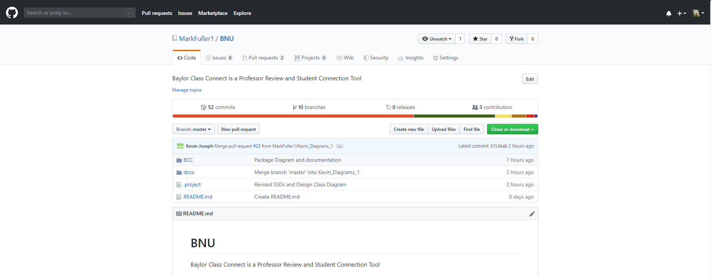
Git
https://github.com/MarkFuller1/BNU/

Slide 16
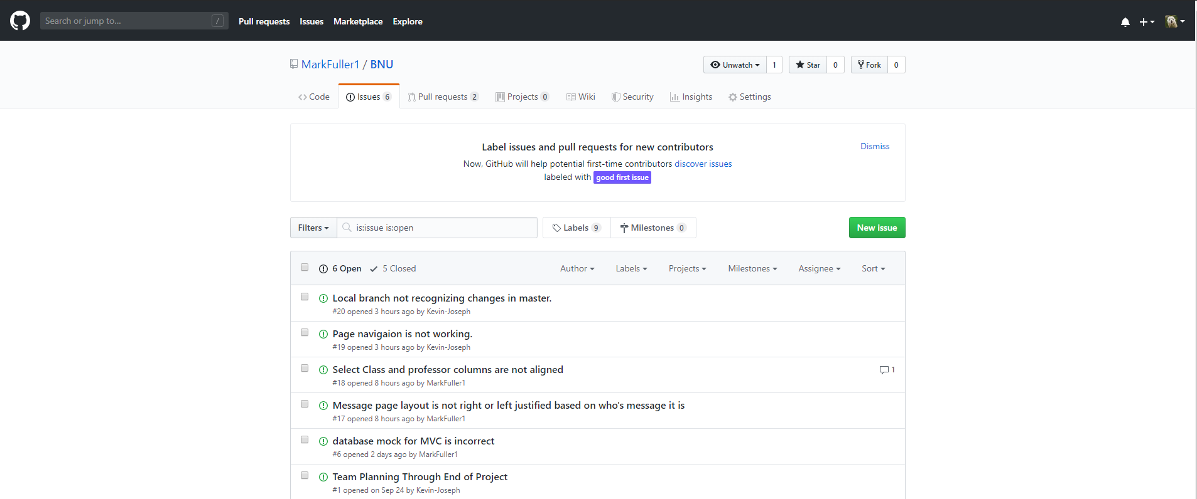
Issue tracking system
https://github.com/MarkFuller1/BNU/issues

Slide 17
Otazky?

Slide 18
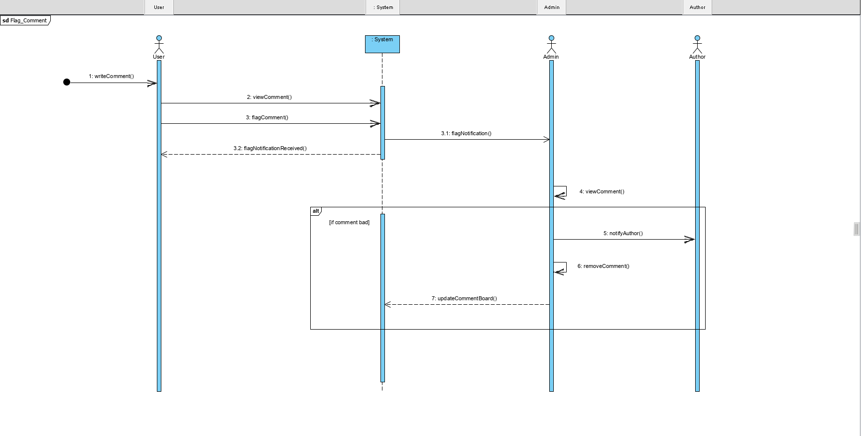
Revised Iteration 1

Slide 19
Space for I1 Separate doc

Slide 20
Point redistribution

Slide 21
TimeCard

